Slide 1
Problem solving with arithmetic procedures involving fractions
Arithmetic procedures with fractions

Slide 2
how to use Oak lessons

Slide 3
I can use my knowledge of arithmetic procedures involving fractions to solve problems.

Slide 4



A proper fraction is a fraction where the numerator is less than the denominator.
Example
An improper fraction is a fraction where the numerator is greater than or equal to the denominator.
Example
A mixed number is an improper fraction written as its integer part plus the fractional part where the fractional part is a proper fraction.
Example

Slide 5

Problem solving with arithmetic procedures involving fractions
Solving problems involving fractions
Using a calculator

Slide 6
Solving problems involving fractions
We use fractions in many different ways in real life. When approaching problem solving questions, have an idea of the strategy or approach needed and then apply those fraction skills.
Identifying the strategy first and then completing the calculation breaks the problem solving question into chunks.
However, understanding the wording is firstly important before identifying a strategy.

Slide 7

Solving problems involving fractions
In real life, we sometimes do not use the words subtract, add, divide or multiply in context questions.
Which operation do you think is associated with the following words?
Difference
Total
Lots of
Sum
Split between
Shared

Slide 8



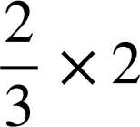
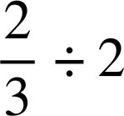
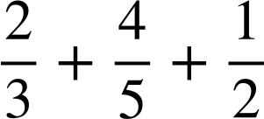
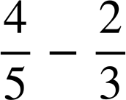
Solving problems involving fractions
Without working out the answer, match the statement with the answer.
The total water of all three students
The difference in water between Lucas and Aisha
Aisha shares her water between two other friends
Two lots of Aisha’s bottle of water

Slide 9
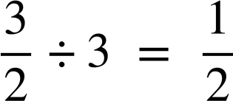
Solving problems involving fractions
Sometimes mathematical words are used to identify when to add, subtract, multiply or divide.
When calculating area of shapes, which operation do we tend to use?
Area of a rectangle = length × width
Multiplication
Area
of
a
triangle
=
× base × height
When calculating perimeter of shapes, which operation do we tend to use?
The perimeter is the total distance around a 2D shape.
Addition

Slide 10
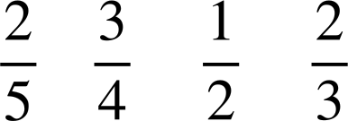
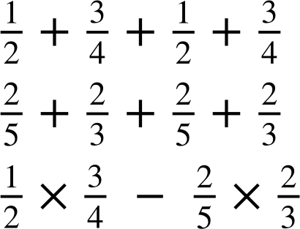
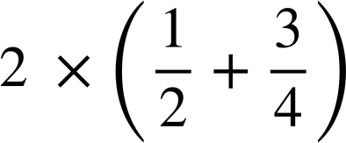
Solving problems involving fractions
For example, which statement matches which calculation?
Rectangle A
Rectangle B
m
m
m
m
The perimeter of rectangle A
The area of rectangle A
The area of rectangle B
The difference in area between area A and area B

Slide 11
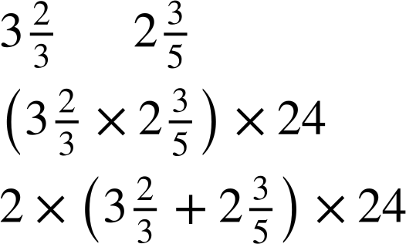
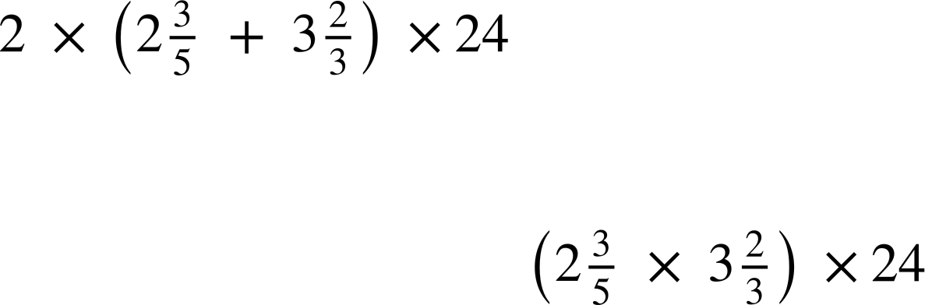
Solving problems involving fractions
Without calculating, match the statements and explain how you knew which statement matched which calculation.
Land A
m
m
The addition of the lengths is perimeter then multiplying by 24 indicates £24 per m
The m² indicates area
Each m² will cost £24
The m indicates perimeter
Each m will cost £24
The multiplication of the lengths is area then multiplying by 24 indicates £24 per m²

Slide 12
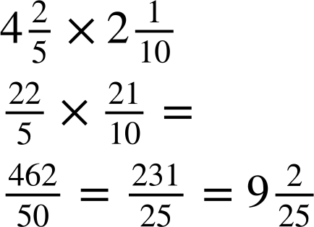
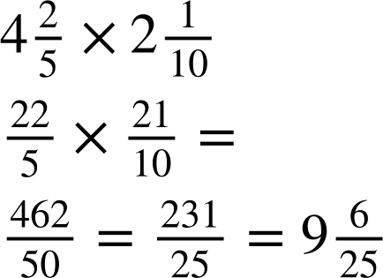
Solving problems involving fractions
A rectangular grass plot of land has lengths
m
by
m.
The Oak teacher wants to plant wildflowers in the plot of land. It costs £10 per m². Without a calculator, how much will it cost the teacher to fill the area with wildflowers?
Grass plot
m
m
rounded up gives 10 m², so the total cost is 10 × £10 = £100

Slide 13
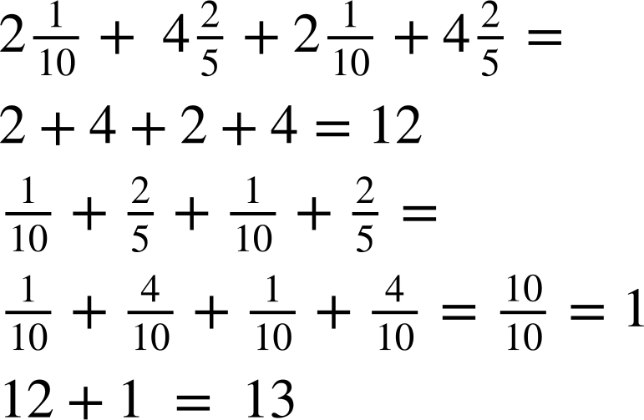
Solving problems involving fractions
A rectangular grass plot of land has lengths
m
by
m.
The Oak teacher wants to put a fence all the way around the plot. The fence costs £5.45 per m. Without a calculator, how much will it cost to fence around the plot?
Grass plot
m
m
The perimeter is 13 m and each metre will cost £5.45, so we multiply £5.45 by 13

Slide 14
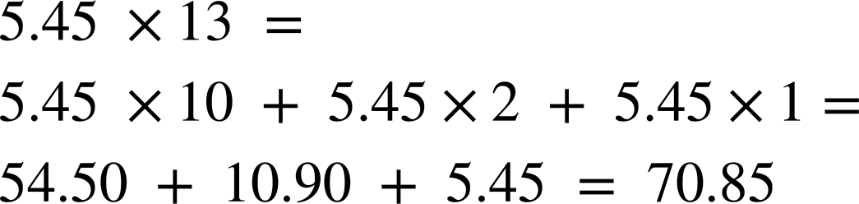
Solving problems involving fractions
A rectangular grass plot of land has lengths
m
by
m.
The Oak teacher wants to put a fence all the way around the plot. The fence costs £5.45 per m. Without a calculator, how much will it cost to fence around the plot?
Grass plot
m
m
The cost to fence around the plot is £70.85

Slide 15
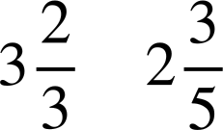
Solving problems involving fractions
For the following questions, do not use a calculator and show all your working out.
1a) A rectangular flower bed has a
Flower bed
m
length
m
and width
m.
Jacob wants to plant flowers in the plot, but needs to buy the compost. The compost bags each cover 1 m² and cost £5.70 per bag. How much will it cost Jacob?
m
b) Jacob also needs to put a metal edging around the plot. The edging is sold in metres for £3.42 per metre. How much will it cost Jacob to put the edging around the flower bed?

Slide 16
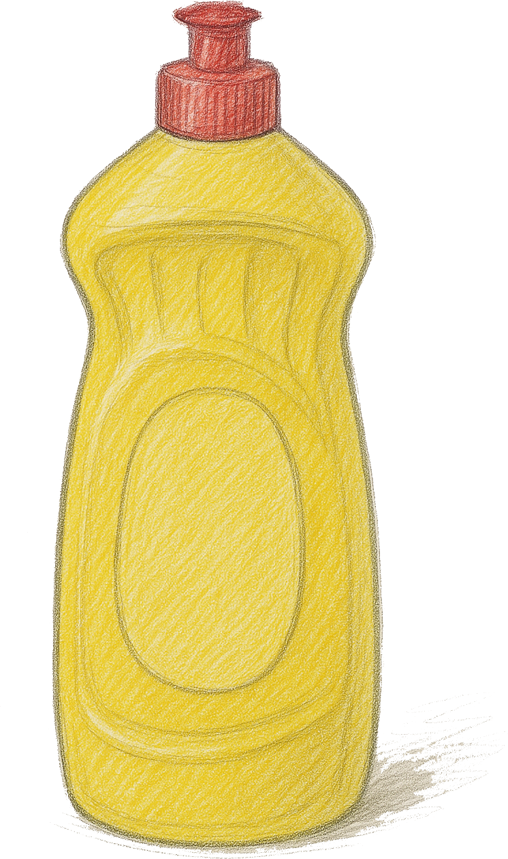

Solving problems involving fractions
For the following question, do not use a calculator and show all your working out.
2) A
bottle
contains
litre of water. On a school trip,
three teachers have a different number of water bottles to give to the students in their groups. Each student gets an equal share.
Teacher A
a) How much water does each teacher have to share?
How much water do the students in each group get if:
b) There are three students in Teacher A’s group?
c) There are six students in Teacher B’s group?
d) There are five students in Teacher C’s group?
Teacher B
Teacher C

Slide 17
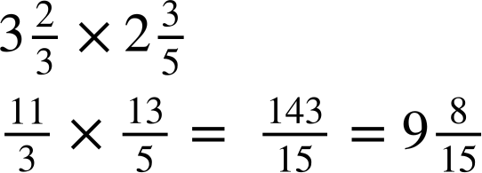
Solving problems involving fractions
1a) A
rectangular
flower
bed
has
length
m
and
width
m. Jacob wants to plant flowers
in the plot, but needs to buy the compost. The compost bags each cover 1 m² and cost £5.70 per bag. How much will it cost Jacob?
Flower bed
m
m
Jacob needs to buy 10 bags each costing £5.70 so it will cost Jacob £57

Slide 18
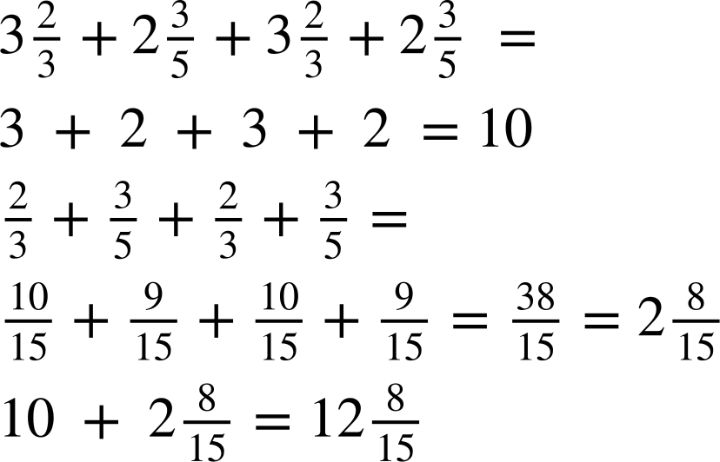
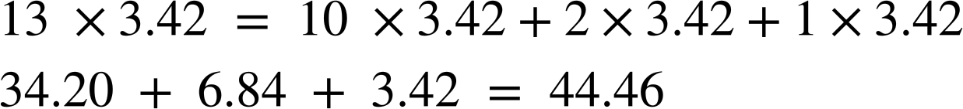
Solving problems involving fractions
b) Jacob also needs to put a metal edging around the plot. The edging is sold for £3.42 per metre. How much will it cost Jacob to put the edging around the flower bed?
Flower bed
m
m
Jacob needs to buy 13 m of fencing at £3.42 a metre.
The total is £44.46

Slide 19


Solving problems involving fractions
2) A
bottle
contains
litre of water. On a school trip,
three teachers have a different number of water bottles to give to the students in their groups. Each student gets an equal share.
Teacher A
How much water does each teacher have to share?
Teacher B
Teacher A litre
Teacher B and C each have 3 litres.
Teacher C

Slide 20
Solving problems involving fractions
2) A
bottle
contains
litre of water. On a school trip,
three teachers have a different number of water bottles to give to the students in their groups. Each student gets an equal share.
Teacher A
How much water do the students in each group get if:
b) There are three students in Teacher A’s group?
Teacher B
Each student gets litre each.
Teacher C

Slide 21
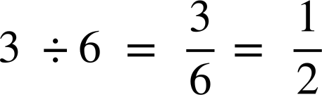
Solving problems involving fractions
2) A
bottle
contains
litre of water. On a school trip,
three teachers have a different number of water bottles to give to the students in their groups. Each student gets an equal share.
Teacher A
How much water do the students in each group get if:
c) There are six students in Teacher B’s group?
Teacher B
Teacher C
Each student gets litre each.

Slide 22
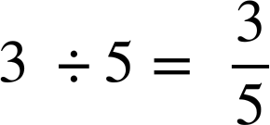
Solving problems involving fractions
2) A
bottle
contains
litre of water. On a school trip,
three teachers have a different number of water bottles to give to the students in their groups. Each student gets an equal share.
Teacher A
How much water do the students in each group get if:
d) There are five students in Teacher C’s group?
Teacher B
Each student gets litre each.
Teacher C

Slide 23
Problem solving with arithmetic procedures involving fractions
Solving problems involving fractions
Using a calculator

Slide 24
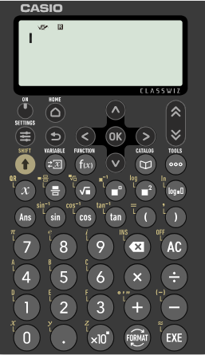
Using a calculator
Scientific calculators are fantastic tools.
The Casio fx 991 classwiz can do so much, including calculating with fractions.
Therefore, it is important to know where all the buttons are associated with fractions.

Slide 25
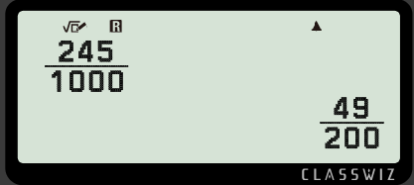
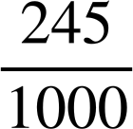
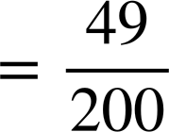


Using a calculator
For example, lets input and simplify
Press 245
1000

Slide 26
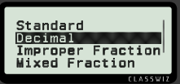
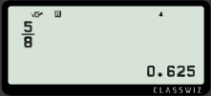
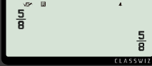



Using a calculator
The Casio fx 991 classwiz allows you to change the format of a number.
Press
5
8
To convert to a decimal

Slide 27
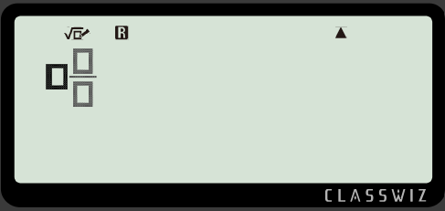


Using a calculator
Now let’s input a mixed number.
The mixed number button is accessed by pressing
SHIFT
then
You can then insert the integer and proper fraction.

Slide 28
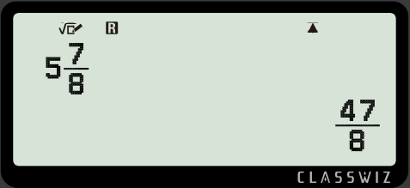

Using a calculator
Now let’s input a mixed number
For example,
Input
into the calculator
SHIFT
Press
Insert
the
mixed
number

Slide 29

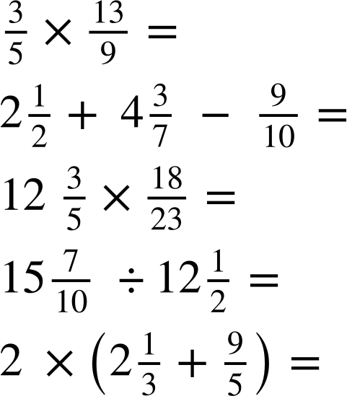
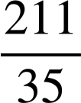
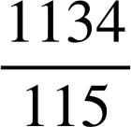
Using a calculator
Using your calculator, work out the following. Make sure to use
SHIFT
for
proper
or
improper
fractions
and
for inputting
then
mixed numbers. Write the answer from your calculator display.
a)
b)
c)

Slide 30
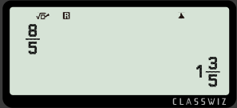
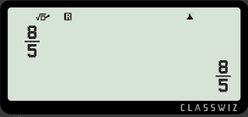
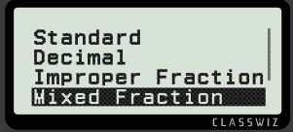
Using a calculator
The Casio fx 991 classwiz allows you to change the format of a number.
Press
8
5
To convert to a mixed fraction

Slide 31
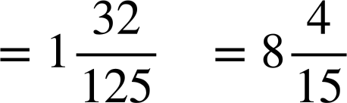
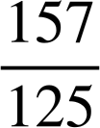
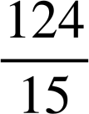
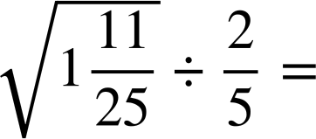
Using a calculator
Using your calculator, work out the following. Make sure to use
SHIFT
for
proper
or
improper
fractions
and
for inputting
then
mixed numbers. Write the answer from your calculator display.
d)
e)
f)

Slide 32
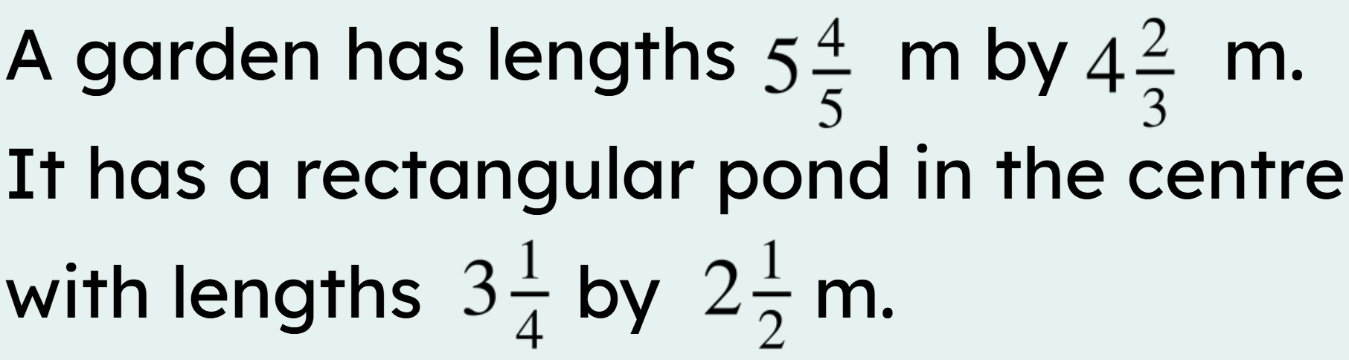
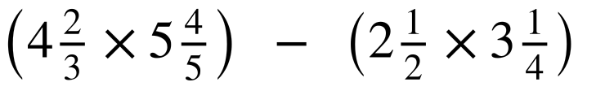
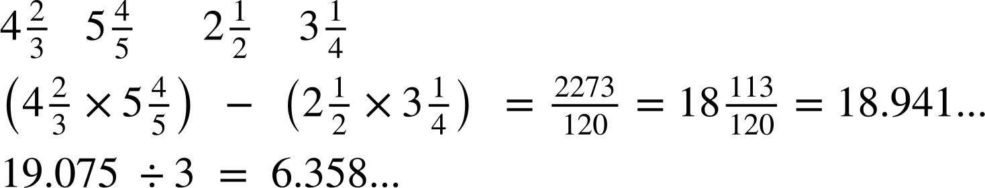
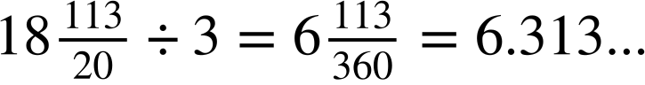
Using a calculator
Use your calculator and give your answer as a decimal.
Grass
Pond
Work out the area of the grass in the garden.
If a bag of seeds cost £6.45 and is sold in boxes covering 3 m², how much would it cost to reseed the grass?
a)
b)
Pond
Area of grass
Whole garden
To reseed the garden, seven boxes are needed. Total cost is 7 × £6.45 = £45.15

Slide 33
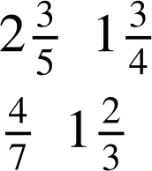
Using a calculator
m
Aisha is restoring some old picture frames. She wants to cover the frame in gold leaf.
Work out the area of the frame.
Gold leaf costs £12.84 per m². How much will it cost Aisha to gold leaf the picture frame?
m
m
m

Slide 34
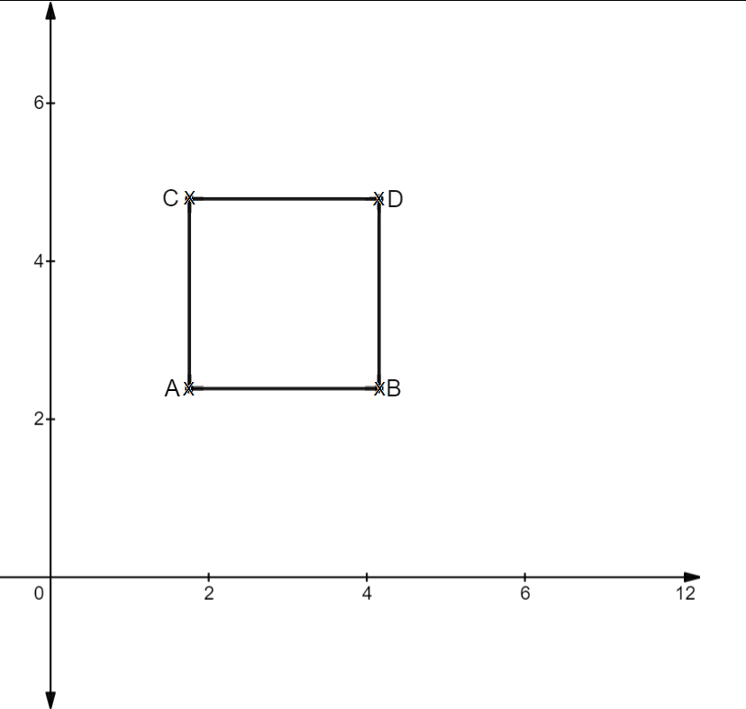
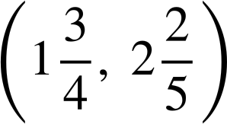
Using a calculator
2) A square with length
units has been plotted
on an axis.
The coordinates of A are
Write the coordinates of B, C and D, giving your answer as a mixed number.

Slide 35
Using a calculator
m
Aisha is restoring some old picture frames. She wants to cover the frame in gold leaf.
Work out the area of the frame.
Gold leaf costs £12.84 per m². How much will it cost Aisha to gold leaf the picture frame?
m
m
m
Therefore, 4 m² sheets are needed. The total cost is 4 × £12.84 = £51.36

Slide 36
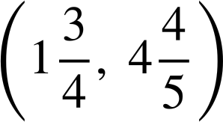
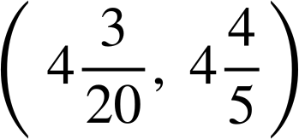
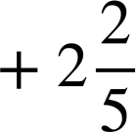

Using a calculator
2) A square with length
units has been plotted
on an axis.
The coordinates of A are
Write the coordinates of B, C and D, giving your answer as a mixed number.
B
C
D

Slide 37
Problem solving with arithmetic procedures involving fractions
We use fractions in many different ways in real life. When approaching problem solving questions, have an idea of the strategy or approach needed and then apply those fraction skills, making sure to understand the key words which indicate which operation to use.
Knowing which buttons to press on a scientific calculator is
important.
Make
sure
to
use
for proper or improper fractions
SHIFT
and
then
for inputting mixed numbers.

Slide 38

© Oak National Academy 2023.
Produced in partnership with Mathematics in Education and Industry.
Licensed on the Open Government Licence v3.0, except where otherwise stated. See Oak terms and conditions.

